Slide 1
Mixed Models Day 4: Beyond the Linear Mixed Model
Cas Kruitwagen

Slide 2
Overview Day 4
Introduction
Generalized linear mixed models (GLMMs)
Combining GLM’s with Mixed Models
Logistic and Poisson
Estimation procedure and software
Extension to Non-linear models (very brief)
Case studies and examples throughout

Slide 3
1
Generalized linear mixed models (GLMMs)

Slide 4
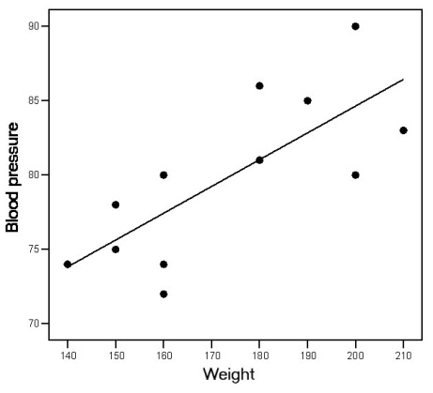
Linear Regression
Data
Continuous outcome variable Y: We assume the outcome for each individual i comes from N(μ_{i} ; σ²).
Approach: we model μ_{i} given a (set of) predictor variable(s) X.
Model
Y_{i} = β₀ + β₁ X_{1i} + ε_{i}
ε_{i} ~ N(0 ; σ²)
ε_{i} independent for i = 1, …, n

Slide 5
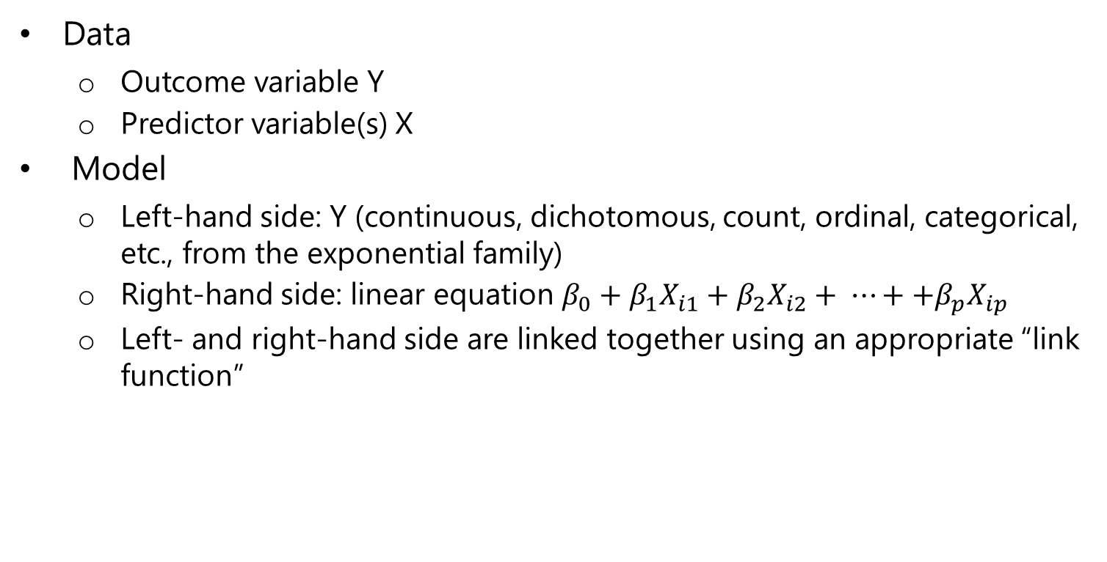
Generalized Linear Models
Data
Outcome variable Y
Predictor variable(s) X
Model
Left-hand side: Y (continuous, dichotomous, count, ordinal, categorical, etc., from the exponential family)
Right-hand side: linear equation $β_{0}+β_{1}X_{i1}+β_{2}X_{i2}+ ⋯++β_{p}X_{ip}$
Left- and right-hand side are linked together using an appropriate “link function”

Slide 6
Generalized Linear Models
Example: logistic regression
Dichotomous outcome variable Y (1/0), e.g.
pregnant (1 = yes, 0 = no),
heart disease (1 = yes, 0 = no).
Assumed distribution of the outcome: binomial.
Each individual i that is drawn can be seen as the outcome of a “Bernoulli trial”, with success probability P(Y_{i}=1).
Principle: we model the success probability P(Y_{i}=1), given a set of predictor variables.

Slide 7
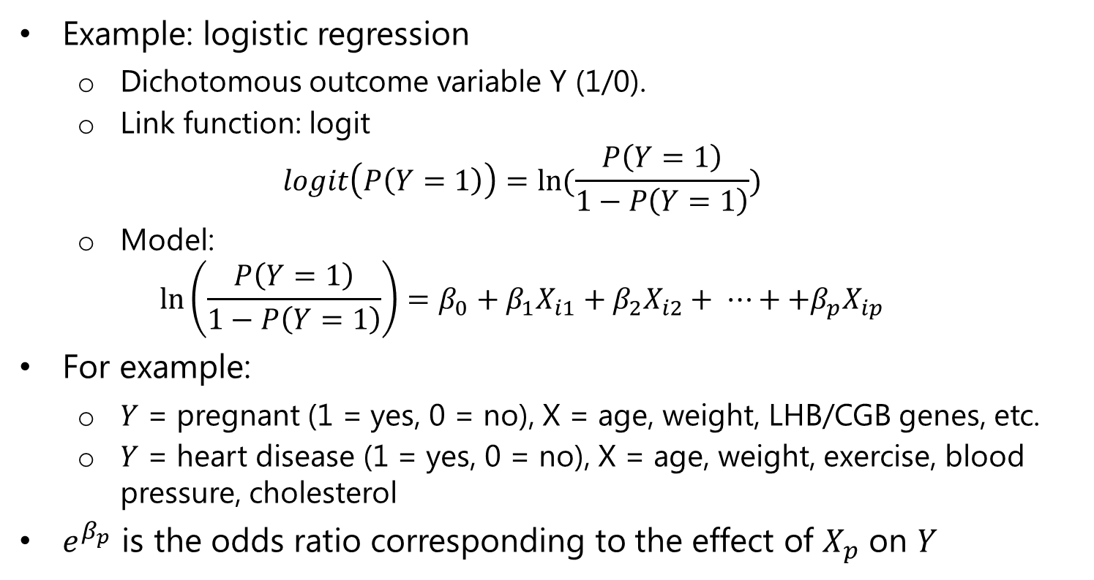
Generalized Linear Models
Example: logistic regression
Dichotomous outcome variable Y (1/0).
Link function: logit
$$logit\left(P\left(Y=1\right)\right)=ln⁡(\frac{P\left(Y=1\right)}{1−P\left(Y=1\right)})$$
Model:
$$\ln\left(\frac{P\left(Y=1\right)}{1−P\left(Y=1\right)}\right)=β_{0}+β_{1}X_{i1}+β_{2}X_{i2}+ ⋯++β_{p}X_{ip}$$
For example:
$Y$ = pregnant (1 = yes, 0 = no), X = age, weight, LHB/CGB genes, etc.
$Y$ = heart disease (1 = yes, 0 = no), X = age, weight, exercise, blood pressure, cholesterol
$e^{β_{p}}$ is the odds ratio corresponding to the effect of $X_{p}$ on $Y$

Slide 8
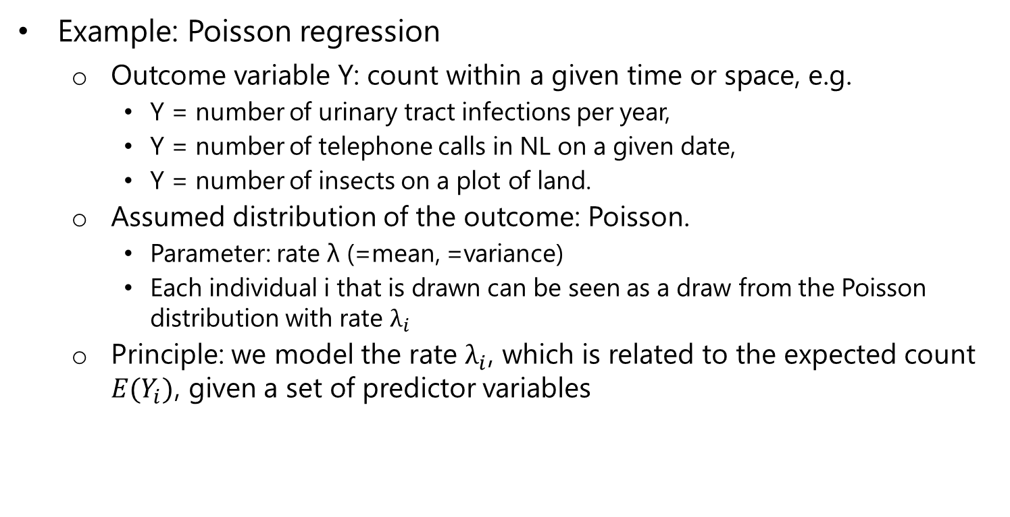
Generalized Linear Models
Example: Poisson regression
Outcome variable Y: count within a given time or space, e.g.
Y = number of urinary tract infections per year,
Y = number of telephone calls in NL on a given date,
Y = number of insects on a plot of land.
Assumed distribution of the outcome: Poisson.
Parameter: rate λ (=mean, =variance)
Each individual i that is drawn can be seen as a draw from the Poisson distribution with rate $λ_{i}$
Principle: we model the rate $λ_{i}$, which is related to the expected count $E(Y_{i})$, given a set of predictor variables

Slide 9
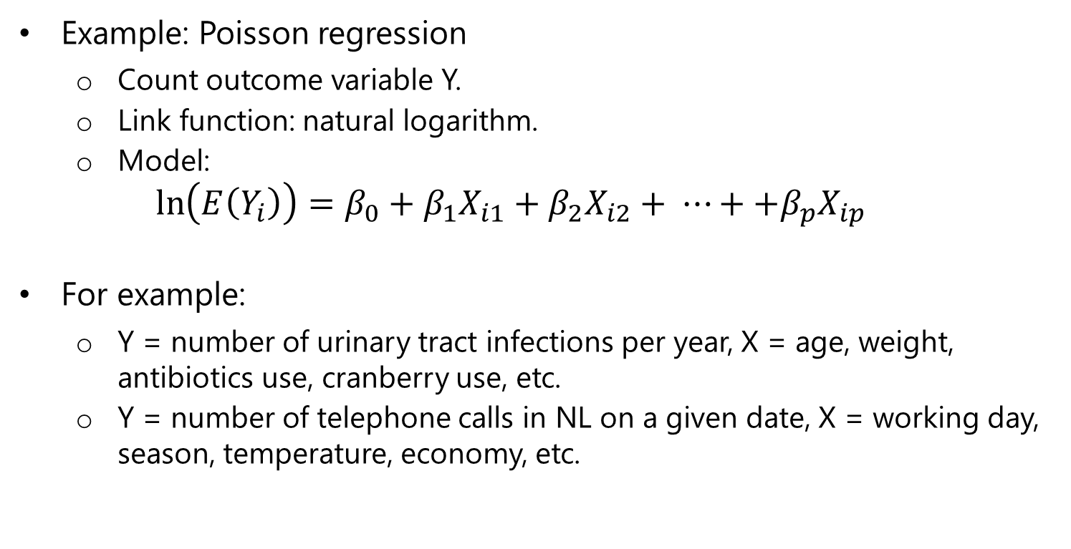
Generalized Linear Models
Example: Poisson regression
Count outcome variable Y.
Link function: natural logarithm.
Model:
$$\ln\left(E\left(Y_{i}\right)\right)=β_{0}+β_{1}X_{i1}+β_{2}X_{i2}+ ⋯++β_{p}X_{ip}$$
For example:
Y = number of urinary tract infections per year, X = age, weight, antibiotics use, cranberry use, etc.
Y = number of telephone calls in NL on a given date, X = working day, season, temperature, economy, etc.

Slide 10
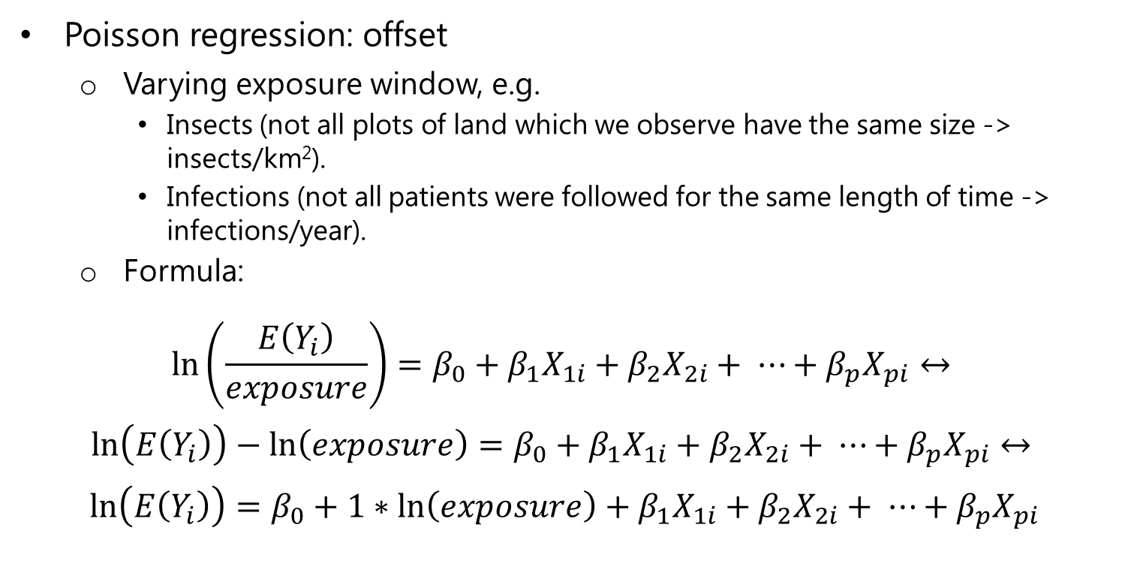
Generalized Linear Models
Poisson regression: offset
Varying exposure window, e.g.
Insects (not all plots of land which we observe have the same size -> insects/km²).
Infections (not all patients were followed for the same length of time -> infections/year).
Formula:
$$\ln\left(\frac{E\left(Y_{i}\right)}{exposure}\right)=β_{0}+β_{1}X_{1i}+β_{2}X_{2i}+ ⋯+β_{p}X_{pi}↔$$
$\ln\left(E\left(Y_{i}\right)\right)−\ln\left(exposure\right)=β_{0}+β_{1}X_{1i}+β_{2}X_{2i}+ ⋯+β_{p}X_{pi}$ $↔$
$$\ln\left(E\left(Y_{i}\right)\right)=β_{0}+1∗\ln\left(exposure\right)+β_{1}X_{1i}+β_{2}X_{2i}+ ⋯+β_{p}X_{pi}$$

Slide 11
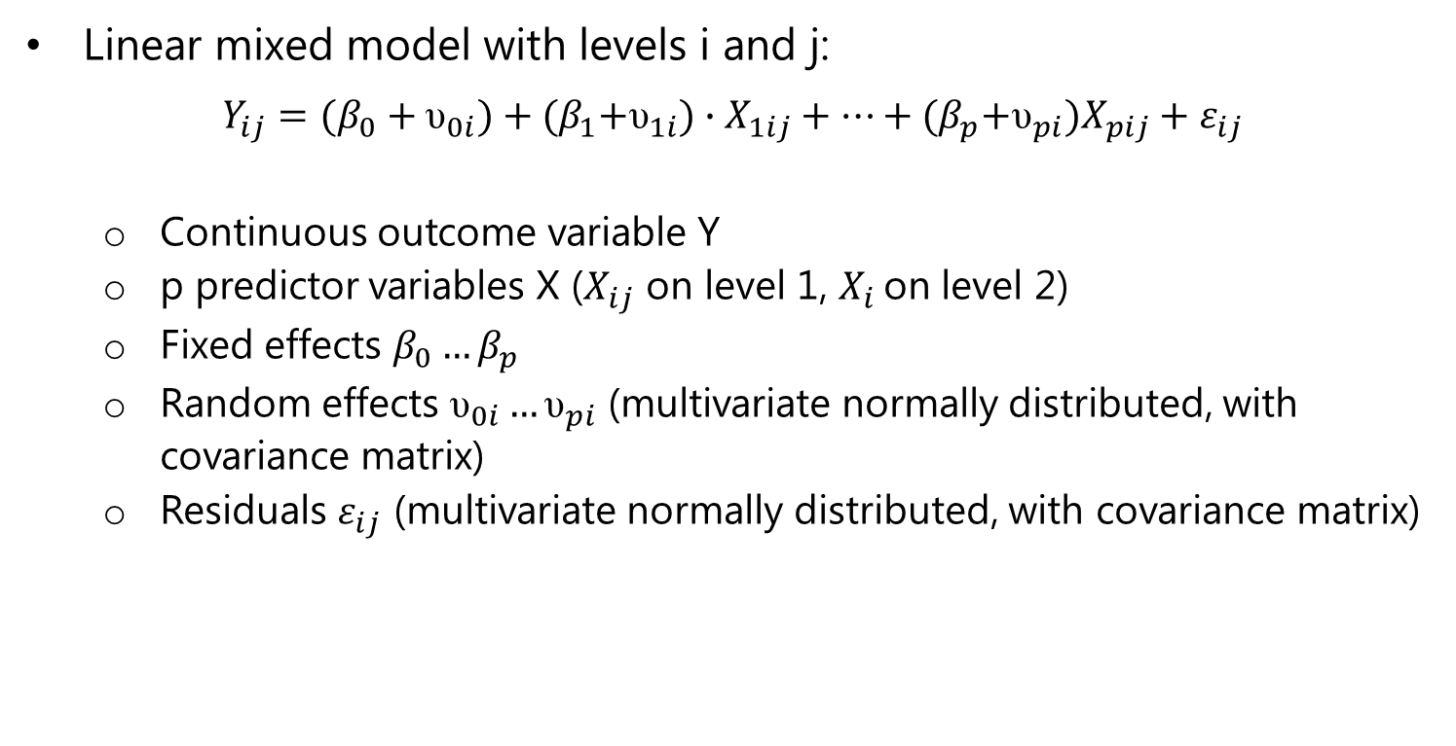
Linear Mixed Models
Linear mixed model with levels i and j:
$$Y_{ij}=(β_{0}+{\text{υ}}_{0i})+{(β}_{1}+{\text{υ}}_{1i})∙X_{1ij}+⋯+{(β}_{p}+{\text{υ}}_{pi})X_{pij}+ε_{ij}$$
Continuous outcome variable Y
p predictor variables X ($X_{ij}$ on level 1, $X_{i}$ on level 2)
Fixed effects $β_{0}…β_{p}$
Random effects ${\text{υ}}_{0i}…{\text{υ}}_{pi}$ (multivariate normally distributed, with covariance matrix)
Residuals $ε_{ij}$ (multivariate normally distributed, with covariance matrix)

Slide 12
Linear Mixed Models
Example: CD4 count
Measured in HIV positive patients, over time (since seroconversion).
Level 1: repeated CD4 measurements (j).
Level 2: individual patients (i).
Level 1 covariate: having active tuberculosis (TB) (1=yes/0=no).
6 example patients (next slide).

Slide 13
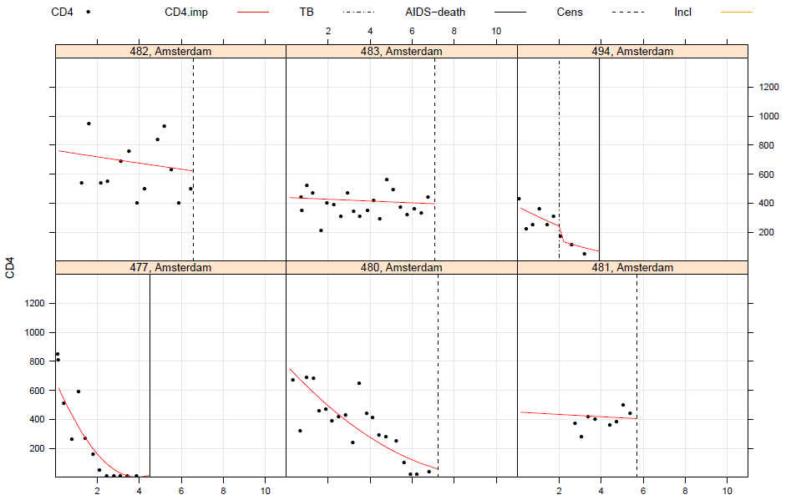
Linear Mixed Models

Slide 14
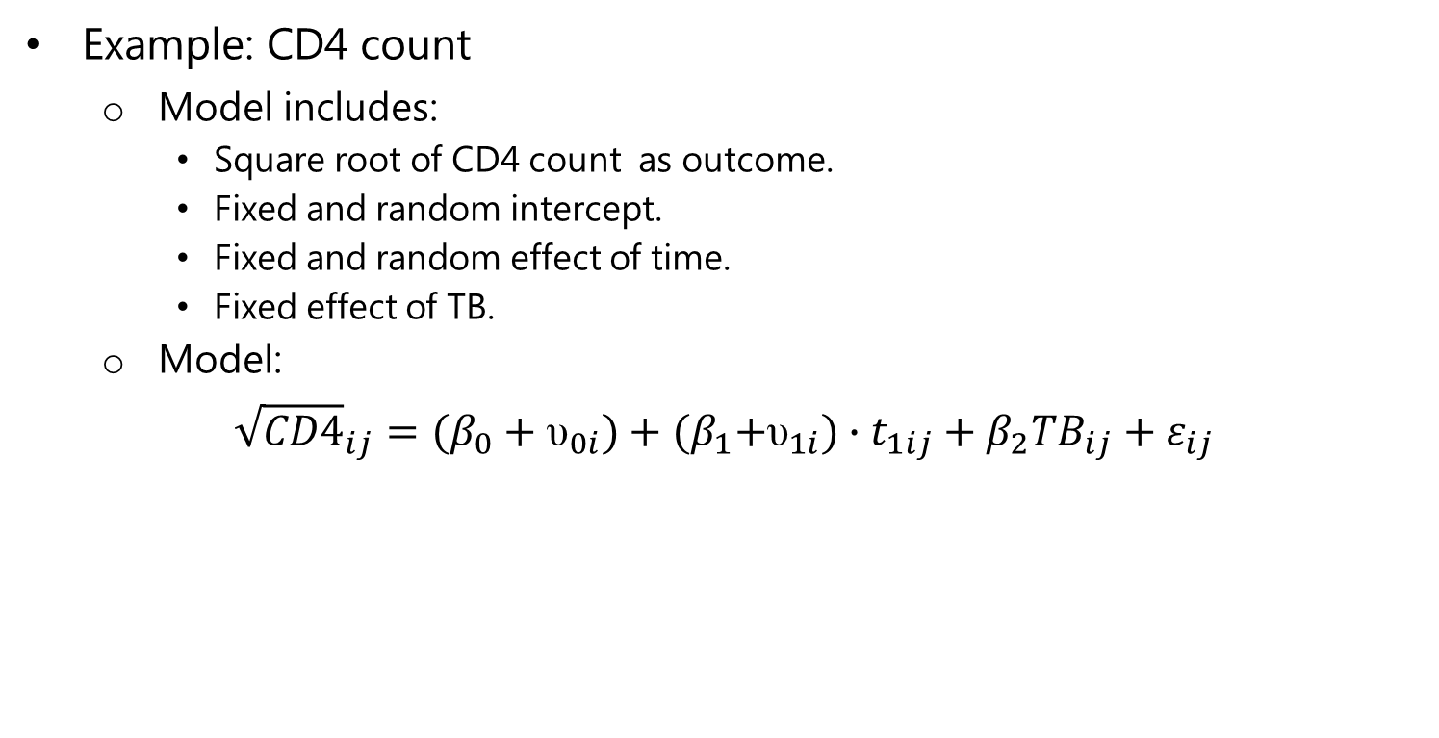
Linear Mixed Models
Example: CD4 count
Model includes:
Square root of CD4 count as outcome.
Fixed and random intercept.
Fixed and random effect of time.
Fixed effect of TB.
Model:
$${\sqrt{CD4}}_{ij}=(β_{0}+{\text{υ}}_{0i})+{(β}_{1}+{\text{υ}}_{1i})∙t_{1ij}+β_{2}{TB}_{ij}+ε_{ij}$$

Slide 15
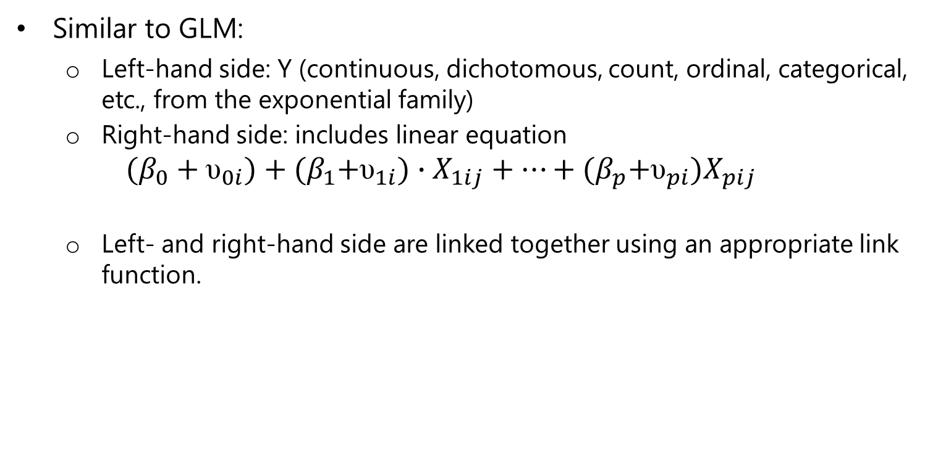
Generalized Linear Mixed Models (GLMMs)
Similar to GLM:
Left-hand side: Y (continuous, dichotomous, count, ordinal, categorical, etc., from the exponential family)
Right-hand side: includes linear equation
$$(β_{0}+{\text{υ}}_{0i})+{(β}_{1}+{\text{υ}}_{1i})∙X_{1ij}+⋯+{(β}_{p}+{\text{υ}}_{pi})X_{pij}$$
Left- and right-hand side are linked together using an appropriate link function.

Slide 16

Generalized Linear Mixed Models (GLMMs)
Example: logistic
$$\ln\left(\frac{P\left(Y_{ij}=1\right)}{1−P\left(Y_{ij}=1\right)}\right)=(β_{0}+{\text{υ}}_{0i})+{(β}_{1}+{\text{υ}}_{1i})∙X_{1ij}+⋯+{(β}_{p}+{\text{υ}}_{pi})X_{pij}$$
Example: Poisson $\ln\left(E\left(Y_{ij}\right)\right)=(β_{0}+{\text{υ}}_{0i})+{(β}_{1}+{\text{υ}}_{1i})∙X_{1ij}+⋯+{(β}_{p}+{\text{υ}}_{pi})X_{pij}$

Slide 17
Example cases
These are analysed in R.
Examples come from the mlmRev package:
install.packages("mlmRev")
Analysis using lme4 package:
install.packages(“lme4")

Slide 18
Example case: contraception
Data: Contraception library(mlmRev) data(Contraception) ?Contraception
These data on the use of contraception by women in urban and rural areas (within districts) come from the 1988 Bangladesh Fertility Survey.

Slide 19
Example case: contraception
Data: Contraception A data frame with 1934 observations on the following 6 variables:
woman - Identifying code for each woman - a factor → level 1
district - Identifying code for each district - a factor → level 2
use - Contraceptive use at time of survey → outcome
livch - Number of living children at time of survey - ordered factor. Levels are 0, 1, 2, 3+ → level 1 covariate
age - Age of woman at time of survey (in years), centered around mean → level 1 covariate
urban - Type of region of residence - a factor. Levels are urban and rural → level 1 covariate (?)

Slide 20
Example case: contraception
Examine the dataset:
> Contraception[1:4,]
woman district use livch age urban
1 1 1 N 3+ 18.4400 Y
2 2 1 N 0 -5.5599 Y
3 3 1 N 2 1.4400 Y
4 4 1 N 3+ 8.4400 Y
> Contraception[501:504,]
woman district use livch age urban
501 501 14 Y 2 -4.5599 Y
502 502 14 Y 1 -5.5599 Y
503 503 14 N 1 -8.5599 Y
504 14 Y 2 0.4400 Y

Slide 21
Example case: contraception
Is urban constant within district?
> with(Contraception, table(district, urban))
urban
district N Y
1 54 63
2 20 0
3 0 2
4 19 11
5 37 2
6 58 7
7 18 0
8 35 2
9 20 3
. . .
# -> No, urban varies within district, so is indeed a level 1 covariate.

Slide 22
Example case: contraception
Some descriptives
> table(Contraception$use)
N Y
1175 759
> table(Contraception$livch)
0 1 2 3+
530 356 305 743
> summary(Contraception$age)
Min. 1st Qu. Median Mean 3rd Qu. Max.
-13.560000 -7.560000 -1.560000 0.002198 6.440000 19.440000
> table(Contraception$urban)
N Y
1372 562

Slide 23
Example case: contraception
Let’s think about the analysis
Dichotomous outcome → logistic regression
Predictors: Number of living children (factor), age, urban
Women (=level 1) live within districts (sample of all districts in Bangladesh, = level 2)
Random intercept at level 2?
Random slope for predictors, at level 2?

Slide 24
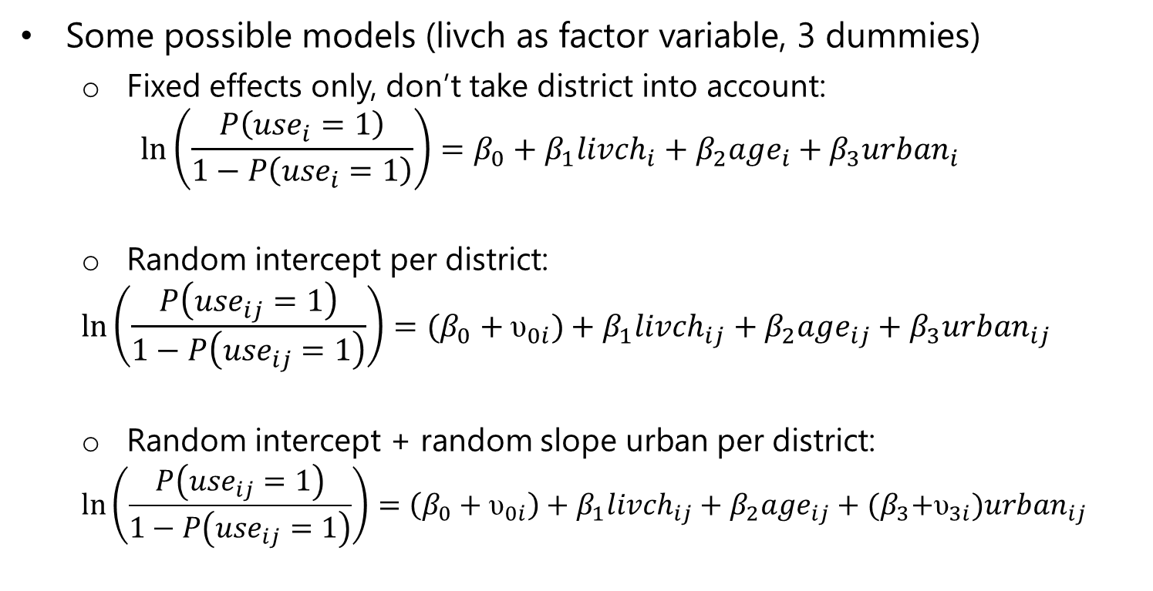
Example case: contraception
Some possible models (livch as factor variable, 3 dummies)
Fixed effects only, don’t take district into account:
$$\ln\left(\frac{P\left({use}_{i}=1\right)}{1−P\left({use}_{i}=1\right)}\right)=β_{0}+β_{1}{livch}_{i}+β_{2}{age}_{i}+β_{3}{urban}_{i}$$
Random intercept per district:
$$\ln\left(\frac{P\left({use}_{ij}=1\right)}{1−P\left({use}_{ij}=1\right)}\right)=(β_{0}+{\text{υ}}_{0i})+β_{1}{livch}_{ij}+β_{2}{age}_{ij}+β_{3}{urban}_{ij}$$
Random intercept + random slope urban per district:
$$\ln\left(\frac{P\left({use}_{ij}=1\right)}{1−P\left({use}_{ij}=1\right)}\right)=\left(β_{0}+{\text{υ}}_{0i}\right)+β_{1}{livch}_{ij}+β_{2}{age}_{ij}+{(β}_{3}+{\text{υ}}_{3i}){urban}_{ij}$$

Slide 25
Example case: contraception
Logistic model for contraception use, regressed on main effects of livch, age and urban, and with a random intercept for each district:
> mod1 <- glmer(use ~ livch + age + urban + (1 | district), family = binomial, data = Contraception)

Slide 26
Example case: contraception
> mod1
AIC BIC logLik deviance
2428 2467 -1207 2414
Random effects:
Groups Name Variance Std.Dev.
district (Intercept) 0.21239 0.46086
Fixed effects:
Estimate Std. Error z value Pr(>|z|)
(Intercept) -1.689710 0.145496 -11.613 < 2e-16 ***
livch1 1.109184 0.156825 7.073 1.52e-12 ***
livch2 1.376396 0.173309 7.942 1.99e-15 ***
livch3+ 1.345234 0.177772 7.567 3.81e-14 ***
age -0.026595 0.007828 -3.398 0.00068 ***
urbanY 0.732918 0.118419 6.189 6.05e-10 ***

Slide 27
Example case: Melanoma Mortality
Data: Mmmec library(mlmRev) data(Mmmec) ?Mmmec
Malignant Melanoma Mortality in the European Community associated with the impact of UV radiation exposure.

Slide 28
Example case: Melanoma Mortality
Data: Mmmec data frame with 354 observations on the following 6 variables:
nation - a factor with levels Belgium, W.Germany, Denmark, France, UK, Italy, Ireland, Luxembourg, and Netherlands → level 3
region - region ID - a factor. → level 2
county - county ID - a factor. → level 1
deaths - number of male deaths due to MM during 1971–1980
→ outcome (number of deaths within county)
Expected - number of expected deaths due to MM. → measure for exposure (based on total number of deaths and person years at risk, used as offset variable).
uvb - centered measure of the UVB dose reaching the earth's surface in each county → level 1 covariate

Slide 29
Example case: Melanoma Mortality
Examine the dataset
> Mmmec[1:4,]
nation region county deaths expected uvb
1 Belgium 1 1 79 51.2220 -2.9057
2 Belgium 2 2 80 79.9560 -3.2075
3 Belgium 2 3 51 46.5169 -2.8038
4 Belgium 2 4 43 55.0530 -3.0069
> Mmmec[301:304,]
nation region county deaths expected uvb
301 Italy 66 302 5 8.2140 6.0751
302 Italy 66 303 11 7.1600 6.6938
303 Italy 67 304 13 13.6230 1.2744
304 Italy 67 305 15 13.9220 1.6140

Slide 30
Example case: Melanoma Mortality
Some descriptives
> as.data.frame(table(Mmmec$nation)) #table in nice format
Var1 Freq
1 Belgium 11
2 W.Germany 30
3 Denmark 14
4 France 94
5 UK 70
6 Italy 95
7 Ireland 26
8 Luxembourg 3
9 Netherlands 11
> length(unique(Mmmec$region)) #number of regions
[1] 78

Slide 31
Example case: Melanoma Mortality
Some more descriptives
> summary(Mmmec$deaths)
Min. 1st Qu. Median Mean 3rd Qu. Max.
0.00 8.00 14.50 27.83 31.00 313.00
> summary(Mmmec$expected)
Min. 1st Qu. Median Mean 3rd Qu. Max.
0.69 11.02 18.76 27.80 34.39 258.90
> summary(Mmmec$uvb)
Min. 1st Qu. Median Mean 3rd Qu. Max.
-8.900000 -4.158000 -0.886400 0.000204 3.276000 13.360000

Slide 32
Example case: Melanoma Mortality
Let’s think about the analysis
Deaths in county (count) → Poisson regression
Counties (=level 1) within regions (sample of regions in EU, = level 2)
Predictor: UVB dose
Random intercept per region?
Random slope for UVB per region?

Slide 33
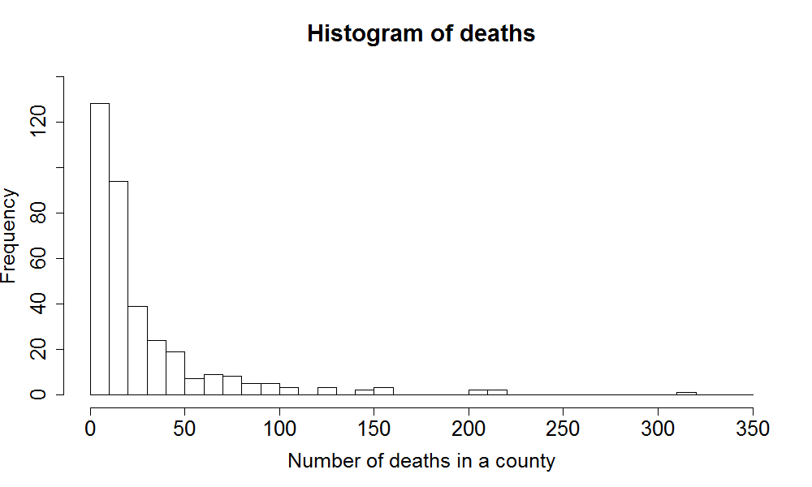
Example case: Melanoma Mortality
Histogram of the outcome variable
> hist(Mmmec$deaths, xlim = c(0, 320), breaks = 320)

Slide 34

Example case: Melanoma Mortality
Expected deaths -> Use offset in Poisson model
$$\ln\left(\frac{E\left({deaths}_{i}\right)}{{expected}_{i}}\right)=β_{0}+β_{1}X_{1i}+ ⋯+β_{p}X_{pi}↔$$
$$\ln\left(E\left({deaths}_{i}\right)\right)=β_{0}+1∗\ln\left({expected}_{i}\right)+β_{1}X_{1i}+⋯+β_{p}X_{pi}$$

Slide 35
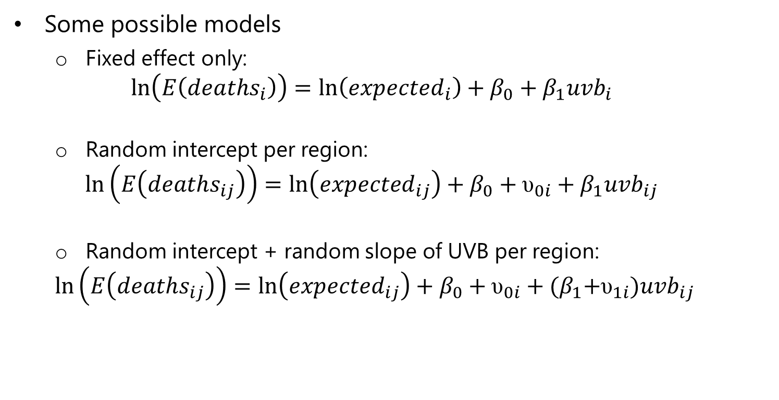
Example case: Melanoma Mortality
Some possible models
Fixed effect only:
$$\ln\left(E\left({deaths}_{i}\right)\right)=\ln\left({expected}_{i}\right)+β_{0}+β_{1}{uvb}_{i}$$
Random intercept per region:
$$\ln\left(E\left({deaths}_{ij}\right)\right)=\ln\left({expected}_{ij}\right)+β_{0}+{\text{υ}}_{0i}+β_{1}{uvb}_{ij}$$
Random intercept + random slope of UVB per region:
$$\ln\left(E\left({deaths}_{ij}\right)\right)=\ln\left({expected}_{ij}\right)+β_{0}+{\text{υ}}_{0i}+{(β}_{1}+{\text{υ}}_{1i}){uvb}_{ij}$$

Slide 36
Example case: Melanoma Mortality
Poisson regression model for deaths, regressed on a main effect of uvb, and including a random intercept for region
> pmod1 <- glmer(deaths ~ uvb + (1|region), family = poisson, data = Mmmec, offset = log(expected))

Slide 37
Example case: Melanoma Mortality
> pmod1
Generalized linear mixed model fit by the Laplace approximation
Formula: deaths ~ uvb + (1 | region)
Data: Mmmec
AIC BIC logLik deviance
661.4 673 -327.7 655.4
Random effects:
Groups Name Variance Std.Dev.
region (Intercept) 0.16968 0.41192
Number of obs: 354, groups: region, 78
Fixed effects:
Estimate Std. Error z value Pr(>|z|)
(Intercept) -0.138601 0.049330 -2.810 0.004959 **
uvb -0.034434 0.009734 -3.538 0.000404 ***

Slide 38
GLMM: parameter estimation
Marginal quasi-likelihood (MQL) -> biased.
Penalized/predictive quasi-likelihood (PQL) -> biased.
Laplace approximation -> accurate, fast, likelihood/AIC/BIC obtainable.
Gauss-Hermite quadrature -> accurate, likelihood/AIC/BIC obtainable, but computationally intensive.
Markov chain Monte Carlo (MCMC) -> very flexible, but computationally intensive.

Slide 39
GLMM: commonly used software
R
MASS package: glmPQL (possible bias, no likelihood/AIC/BIC)
lme4 package: glmer (Laplace approximation)
MCMglmm package (MCMC)
SAS
PROC GLIMMIX (Laplace)
WinBUGS
Bayesian inference (MCMC)
MLwiN

Slide 40
Comparing GLMMs with Laplace approximation
Comparing the models
AIC: lower is better.
Model with -2LL significantly lower is better.
Model with -2LL not significantly different, but with less parameters is better.

Slide 41
3
Non-Linear Mixed Models (NLMMs)

Slide 42
Non-exponential non-linear models
We covered some often-used GLMM’s
Other random effect-models can be defined, e.g. non-linear models not from the exponential family, with random effects.
Example: children with development of motor function.
Motor function distribution defined by asymptote (maximum level), and rate of change (increase with age in motor function)
Asymptote and rate can differ between children
Non-linear asymptotic regression with random effects
Software: nlme package (R) -> nlme function with SSasymp term.

Slide 43
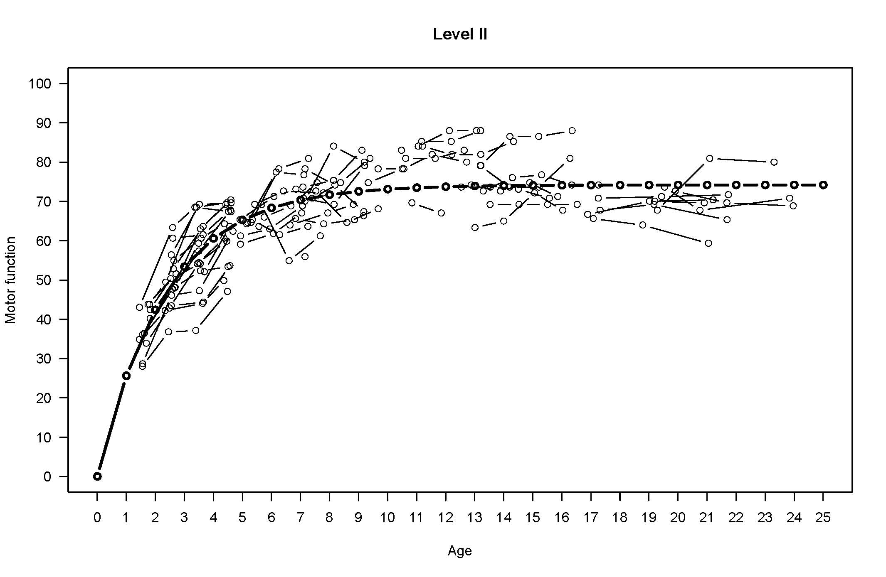
Non-exponential non-linear models
Fitted curve (fixed effect), with individual data points:

